Slide 1
UNIT 6 Simulation Language
SIMULATION AND MODELING

Slide 2
6. Simulation languages
6.1 Types of simulation languages
6.2 Discrete systems modeling and simulation with GPSS
6.3 GPSS programs applications
6.4 SIMSCRIPT - Organization of a SIMSCRIPT program
6.5 SIMSCRIPT programs

Slide 3
Introduction
A computer simulation language describes the operation of a simulation on a computer.
Most languages also have a graphical interface and at least simple statistical gathering capability for the analysis of the results.
In a sense, these languages are similar to languages like Fortran, Java, or VB.NET but also include specific features to facilitate the modeling process.
Some examples of modern simulation languages are GPSS and SIMSCRIPT etc.

Slide 4
Merits of Simulation Language
Since most of the features to be programmed are in-built, simulation language are comparatively less programming time and effort.
Since the simulation language consists of blocks, specially constructed to simulate the common features, they provide a natural framework for simulation modeling.
The simulation models coded in simulation languages can easily be changed and modified.
The error detection and analysis is done automatically in simulation language.
The simulation models developed in simulation languages, especially the specific application packages, called simulators, are very easy to use.
Random number generator and related set of tools.
Provides tools for reporting result.
Simulation clock or mechanism for advancing simulated time.

Slide 5
Advantage of using simulation packages over programming language
Simulation package automatically provide features needed to build a simulation model, resulting significant decrease in programming time and project cost.
It provides natural framework for simulation modelling.
Simulation models are generally easier to modify & maintain when written in a simulation package.
They provide better error detection because many potential types of error are checked for automatically.

Slide 6
Working on Simulation Language:
Most discrete event simulation language model a system by updating the simulation clock to the time that the next event is scheduled to occur.
Events and their scheduled times of occurrence are maintained automatically on one of two order list, the current event chain or future event chain. The current event chain keeps a list of all events that will occur at the present clock time.
The future event chain is a record of all events that can occur at some point in the future.
A simulation clock moves to the next event on the future events chain and changes the system state of the model based on the characteristics of that event.

Slide 7
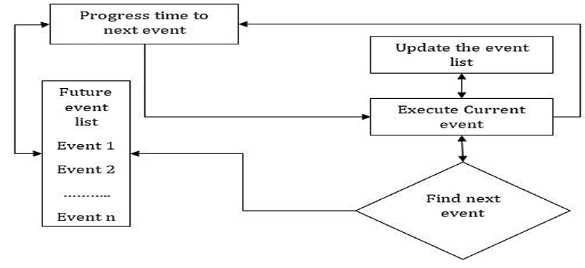
Working on Simulation Language:

Slide 8
Features of Simulation Software:
1. Modeling Flexibility:
The simulation must be flexible enough to adapt to change the configuration. The domain of application should be wide and the model should be equally valid over the whole domain.

Slide 9
2. Ease of Modeling:
It should be easy to develop the simulation model, easy to debug the program and validate the model. The software should have an in-built interactive debugger, error detector and online health.

Slide 10
3. Fast Execution Speed:
The speed of execution is always a very important requirement of any simulation model.
It is especially an essential feature in case of simulation of a large and complex system.
4. Compatibility to Various Computer System:
The simulation language should be compatible with various computer system like
microcomputer, engineering workstation minicomputers and mainframe computers.

Slide 11
5. Statistical Capabilities:
A simulation software should contain multiple stream random number generators and as many standards probability distributions as possible. It should have blocks for designing the statistics like the simulation run, warming up period and the number and the length of replication.
6. The Capability of Animation:
The animation capability of the simulation package is one of the main reasons for the popularity of simulation language. The animation is carried out in two modes i.e. concurrent mode and playback mode.

Slide 12
7. Report Presentation Capabilities:
The output of the simulation the model should be well documented and illustrated. The user should be able to get the information of its interest in the easily understandable form.

Slide 13
Types of Simulation Language
There are following types of simulation languages:
Continuous system simulation language (CSSLs)
Discrete system simulation language (DSSLs)
Hybrid system simulation language (HSL)

Slide 14
Continuous System simulation language
Before digital computers come into common use, analog computers were being used for simulating continuous system.
The system in an analog computer was represented by the block of electronic devices such as operational amplifier to carry out the required operation.
As soon as the digital computer came, it provides many advantages over analog computer like greater accuracy, freedom for scaling, easily stored for reuse etc.

Slide 15
Therefore, a special program package were implemented on digital computer to make a digital computer play like analog computer.
This is called a digital analog simulators.
Example: DEPI, DEPI-4, DAS, MIDAS, IBM-1130, CSMP etc

Slide 16
Types:
Block structured continuous simulation language
These are designed to simulate only those systems that could be represented as analog block diagrams, thus their application area is limited.
It requires user to prepare an analog computer type block diagram and then input it in this diagram.

Slide 17
Expression based language
A block-oriented continuous system simulation language is limited because of its small specialized vocabulary.
Since the system must be represented first in an analog block diagram, so this language is suited only for the analog system and not for those who model the system as a set of equations.
Expression based language or statement-based language overcomes this drawback.
Expression based language do not follow block structure diagram but directly implements the different equation of the model.

Slide 18
Discrete System simulation language
These languages are used to simulate discrete systems and provide the following facilities:
Automatic generation of random no.
Automatic data collection
Statistical analyses of data
Reporter generators, etc.
The other classification of discrete simulation languages is based on the general world view inherent in the language.

Slide 19
Types:
Event oriented language
In an event-oriented language, each event is represented by an instantaneous occurrence in simulated time and must be scheduled to occur in advance when a proper set of conditions exists.
The system image changes its state or system changes at the occurrence of an event. Example, SIMSCRIPT, GASP

Slide 20
Activity oriented language
In an activity-oriented language, the discrete occurrences are not scheduled in advance.
They are created by a program which contains a description of the conditions under which an activity can take place.
The activity-oriented language has two components: Test component and action component.
Here the event occurrence must be controlled by a cyclic scanning activity program. Example, MILITRAN.

Slide 21
Process oriented language
Here a single process routine, composed of a number of segments, describes a sequence of activities.
Each segment behaves as an independently controlled program.
Once given control, only the statements composing the segments are executed, and then control is returned.
Example: PASPOL, SIMUFOR
Transaction flow oriented languages
These languages are the sub-category of process-oriented language where flow of activities passes through a specially defined block.
System model is represented by a flow chart consisting of language.

Slide 22
Hybrid System Simulation Language
Some languages have been developed which are suitable for both discrete as well as continuous models.
This type of language is called hybrid system simulation language or combined simulation language.
These are written particularly for system models in which some of the variable changes continuously, and other variable changes discretely.
Example, GASP IV.

Slide 23
GPSS (General Purpose Simulation System)
GPSS, one of the earliest DSL was developed by Geoffrey Gordon (1961-1962).
The first release of this language was implemented on the IBM 704, 709, and 7090 computers.
Later on improved and more powerful versions have been developed and implemented including GPSS 2nd, GPSS 3rd (1965), GPSS 1360 (1967) and GPSS V (The latest version).

Slide 24
GPSS (General Purpose Simulation System)
GPSS was designed especially for those analyses who weren’t necessarily computer programmers because they do not write programmed in the logic as the SIMSCRIPT programmer does.
Instead, he constructs a block diagram — a network of interconnected blocks, each performing a special simulation-oriented function.
GPSS is particularly suited for traffic and queuing systems.

Slide 25
Characteristics of GPSS
Designed for analysts, not programmers.
GPSS is described as a block diagram in which the block represents the activities, and the lines joining the block indicate the sequence in which the activities can be executed.
GPSS V is a set of 48 different block types which perform some specific task.
Machine efficiency is poor because GPSS is an interpreted system.
Restricted to simple queuing problems.

Slide 26
GPSS Block Diagram
The development of a simulation model in GPSS is a block-by-block construction.
A set of standard blocks is arranged in the form of a block diagram that represents the flow of entities (transaction) through the various paths of the system.
Each block represents a step in the system, and links, joining the blocks, represent the sequence of events that can occur.
To build a block diagram, it is essential to have a completed description of the system.

Slide 27
GPSS Block Diagram....cont..
The meanings of the blocks used in the system must be clearly defined.
Each block must be assigned the block time, i.e., the time which the execution of the block will take.
A set of block types have been designed, which can be used in the construction of a block diagram.
Each block type can be used any number of times in a block diagram, but the total number of blocks should not exceed 2047.

Slide 28
GPSS Block Diagram....cont..
On the completion of the block diagram, each block is assigned a number between 1 and 2047, automatically called the block number or block identification number or location.
The system to be simulated in GPSS is described as a block diagram in which blocks represent activities and lines joining the blocks indicate the sequence in which the activity can be executed.
Each block performs a simulated oriented function.
GPSS V provides a set of 48 different blocks, each of which can be used repeatedly.

Slide 29
GPSS Block Diagram....cont..
Each block has a name and specific task to perform.
Each block type has a number of data fields such as A, B, C, and so on.
The entities of the system being simulated are called as transactions.
Example: Customer in a queuing system, message in a communication system.

Slide 30
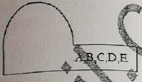
Typical blocks are:
GENERATE: Create transaction and place on future event chain
GENERATE A, B, C, D, E
Create Xact for future entry into the system
Birth block
A: Mean value of interarrival time
B: Half-range of interarrival time
B ≤ A
C: Start delay time
D: Creation limit
E: Priority
Interarrival time uniformly distributed in A ± B

Slide 31
TERMINATE: Removes transaction from the system
TERMINATE A
Destroys an Xact A
Death block
A: Termination count increment
When Xact moves into block, transaction count value is incremented by A and continues until some predefined simulation steps.

Slide 32
Advance: The block type 'ADVANCE' is concerned with representing the expenditure of time. The program computes an interval of time called an action time for each transaction as it enters an 'ADVANCE' block; transaction remains at this block up to that action time.
ADVANCE A,B
delay movement
A: mean value for delay amount A,B
B: half range for delay amount
delay amount uniformly distributed in A+B

Slide 33
Transfer: The 'TRANSFER' block allows some location other than the next sequential location to be selected, i.e., when there is choice of activities, we use this block by stating the condition for the choice. The choice is normally between 2 blocks refer to as next block 'A' and 'B'.
TRANSFER A,B,C
jump to new location
A: probability or mode B C
determines which block to choose A
probability shows transfer to location C
if empty: unconditional transfer to location B
Both: chooses empty block (B first if both empty)
B: block location
C: block location
Example: TRANSFER 0.1, ACC, REJ means 10% go to location REJ(exit2) and 90% to ACC(exit1).

Slide 34
Characteristics of the Blocks
Transactions (Xacts):
In each system represented by a block diagram, some entities pass through the system.
In petrol pump system, they may be vehicles, in a production system they may be parts and in supermarket system they may be customers.
Those entities are referred to as Transactions.
In simulation the transactions are created, which move through the block diagram in the same way, as the entities pass through the actual system being simulated.
There can be many transactions simultaneously moving through the block diagram.

Slide 35
Block / Action Time:
The block time also called action time is an integer giving the number of units required to execute the action represented by the block.
The program computes an action time for each transaction entering a block to represent the time taken by the system action simulated by the block.
The program computes and interval of time called action time for each transaction as it enters and ADVANCE block, and the transaction remains at the block for this interval of simulated time before attempting to proceed.
The action time may be a fixed interval or a random variable.
An action time is defined by giving a mean and modifier. Example, T=A±B where A is the mean and B is the modifier.

Slide 36
Succession of Events:
The program maintains records of when each transaction in the system is due to move.
It proceeds by completing all movements that are scheduled for execution at a particular instant of time and that can be logically performed.
When there is more than one transaction due to move, the program processes transactions in the order of priority or FCFS basis.
Normally, a transaction spends no time at a block other than ADVANCE block.

Slide 37
Once the program begun moving a transaction, it continues to move the transaction through the block until one of the following circumstances occur:
i. The transaction enters ADVANCE block with non zero action time then it wakes up other transaction and return to itself when action time is expended.
ii. The transaction enters TERMINATE block then the transaction is removed from simulation.
iii. The transaction is blocked because some action the transaction is attempting to perform in particular block can't be perform currently (may be lack of resources). However, the program automatically detects when the blocking condition has been removed then the transaction will start to move.

Slide 38
Selection Factor/Choice of path
The TRANSFER block allow some location other than the next sequential location to be selected.
The choice is normally between two blocks referred to as blocks B and C as shown in above figure (also called as exit1 and exit2).
The choice of which exits to be followed is given by a number called the selection factors, S (0 < S < 1) which is entered in the block. S is the probability of selecting exit2 and 1 - S is the probability of selecting exit1.

Slide 39
Items of Equipment
In each system, there are physical equipment, which perform some operation on the transactions.
Machine tools in a production shop perform machining operations on work pieces.
Example, in transportation system, a toll booth on a road is equipment, while vehicles are transactions.
In Factory Manufacturing system, an inspector is equipment, while parts are transaction, etc.
The item of equipment may operate the transactions individually or may handle groups.

Slide 40
Storage and Facilities
Item of equipment can be classified into storage and facilities, depending upon the capacity for handling the transactions.
An item of equipment, which can handle only one transaction at a time, is called a facility while the item of equipment, which can handle a large number of transactions at the same time is called storage.
Example: In communication system, message is transaction, switch (pass only one message) is facility while trunk (collection of wire carrying messages simultaneously) is storage.

Slide 41
Example 1: Simulation of manufacturing shop
In a manufacturing shop, a machine tools turns out parts at the rate of one every five minutes. As they are finished the parts go to inspector, who takes 4±3 minutes to examine each part and rejects 10% of parts. Each part will be represented by one transaction and time unit selected for problem will be one minute. Simulate for 100 parts to leave the system.

Slide 42
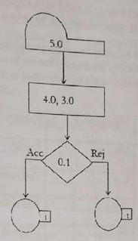

Slide 43
GENERATE 5 ; Parts are generated every 5 minutes
ADVANCE 4,3 ; Inspection time: 4±3 minutes
TRANSFER , ACCEPTED ; If test fails, part is accepted
TRANSFER REJECTED ; If test passes, part is rejected
ACCEPTED TERMINATE 1 ; Accepted parts leave the system
REJECTED TERMINATE 1 ; Rejected parts leave the system
START 100 ; Simulate for 100 parts

Slide 44
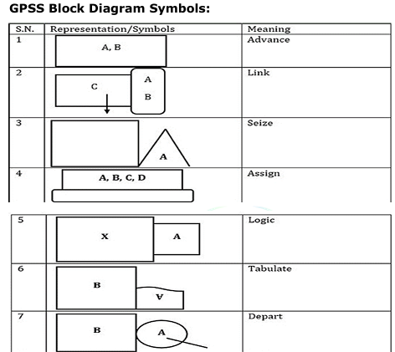

Slide 45
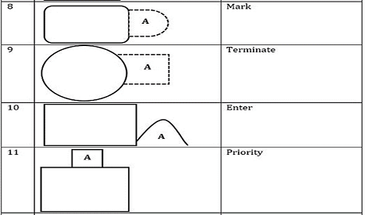

Slide 46
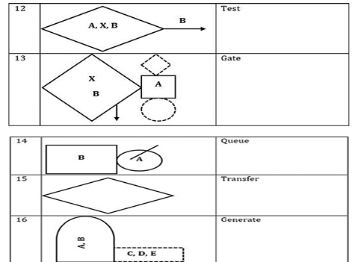

Slide 47
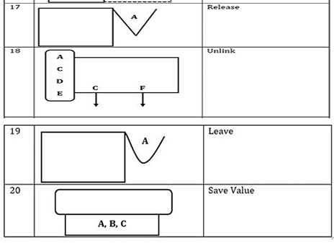

Slide 48
EXAMPLE
Consider a bank with 3 service counters where customer arrival time is an average of 5, with a variance of 2 minutes.
If any customers find the first service counter busy, he/she goes to another service counter, but it takes 3 extra minutes to move into another service counter; similar condition for reaching the third counter.
It takes an average of 10 minutes to provide service to any customer with 2, 3, 4 minutes’ variance respectively at counters 1, 2, and 3.
Develop a GPSS model considering 20% of customers do not get proper services.

Slide 49
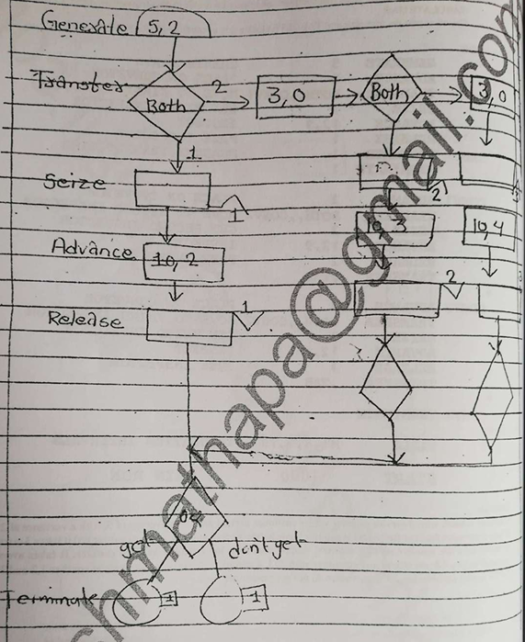

Slide 50
SIMSCRIPT Program
The SIMSCRIPT programming system is especially designed to facilitate the writing of simulation programs.
SIMSCRIPT is a very widely used language for simulating discrete systems.
This language is very FORTRAN in appearance.
SIMSCRIPT II.5 can be viewed as a general programming language with extra features for discrete event simulation.
Because of this general power and FORTRAN-based nature, SIMSCRIPT has been widely implemented and used as a discrete simulation language.
The language can be considered more than just a simulation language since it can be applied to general programming problems.

Slide 51
SIMSCRIPT Program
SIMSCRIPT is a very widely used language for simulating the discrete system. The
language can be considered as more than just a simulation language since it can be
applied to general programming problems. The description of the language given is
organized in five levels.
1. Beginning with simple teaching, level to introduce the concept of programming.
2. The description add level corresponding to a specific programming language.
3. A general-purpose language.
4. A list processing language, needed for creating the data structure of a simulation
model.
5. The simulation-oriented function needed to control the simulation and gathering
statistics.

Slide 52
SIMSCRIPT System Concept
The system to be simulated is considered to consist of entities having attributes that interact with activities. The interaction causes events that change the state of the system.
In describing the system, SIMSCRIPT uses the terms entities, attributes, sets, and event routines. When an entity is created, it can be interpreted as a generic definition for a class of entities.
Individual entities have values for all attributes, which define the particular state of the entity. Attributes are named, not numbered. For example, we may define an employee to be an entity and AGE, SALARY as attributes.
Entities can be of 2 types:
Permanent
Temporary

Slide 53
The temporary entities represent those entities are created and destroyed during the
execution of a simulation while permanent entities represent that entities remain during the run.

Slide 54
A special emphasis is placed on the manner in which temporary entities form sets. SIMSCRIPT uses pointers to tie together entities that are members of sets. Commands are available to manipulate these sets. The user can define facilities for entering and removing entities into and from prompt sets.
Activities are considered as extending over time with their beginning and their end being marked as events occurring instantaneously. Each type of event is described by an event routine, each of which is given a name and programmed as a separate closed subroutine. Events may be:
Endogenous event (Internal)
Exogenous event (External)

Slide 55
Endogenous event (Internal)
Results from action within the system.
An endogenous event is caused by a scheduling statement in some event routine. The event marking the beginning of an activity will usually schedule the event that marks the end of the activity. If the beginning or ending of an activity implies the beginning of some activity, then the event routine marking the beginning or end of the first activity will schedule the beginning of the second.

Slide 56
Exogenous event (External)
Results from action in the system environment.
Exogenous events require the reading of data supplied by the user.
There can be many data sets representing different sets of external events such as the time at which the event occurs.
Event routines are needed to execute the changes that result when an external event becomes due for execution.
In practice, external events such as arrival are often generated using the bootstrap method.

Slide 57
Structure / Organization of SIMSCRIPT program
Since the event routines are closed routines, some means must be provided for control between them. The transfer is affected by the use of event notice which is created when it is determined that an event is scheduled. At all time, an event notice exists for every indigenous event scheduled to occur either at current clock time or in the future event.
Each event notice records the time is due to occur and the event routine that is to execute the event. If the event is to involve one of the temporary entities, the event notice will usually identify which one is involved.

Slide 58
The event notice is filed in chronological order. When all events that can be executed at a particular time have been processed, the clock is updated to the time of the next event notice and control is passed to the event routine identified by the notice. Their actions are automatic and do not need to be programmed and event notice do not usually go to more than one activity.
If the event executed by a routine result in another event, either at the current clock time or in future, the routine must create a new event notice and file it with the other notice.

Slide 59
In the case of the exogenous event, a series of exogenous event statement are created one for each event. All exogenous event statements are sorted to chronological order and they are read by the programs when the time for the event is due to occur.

Slide 60
